Slide 1
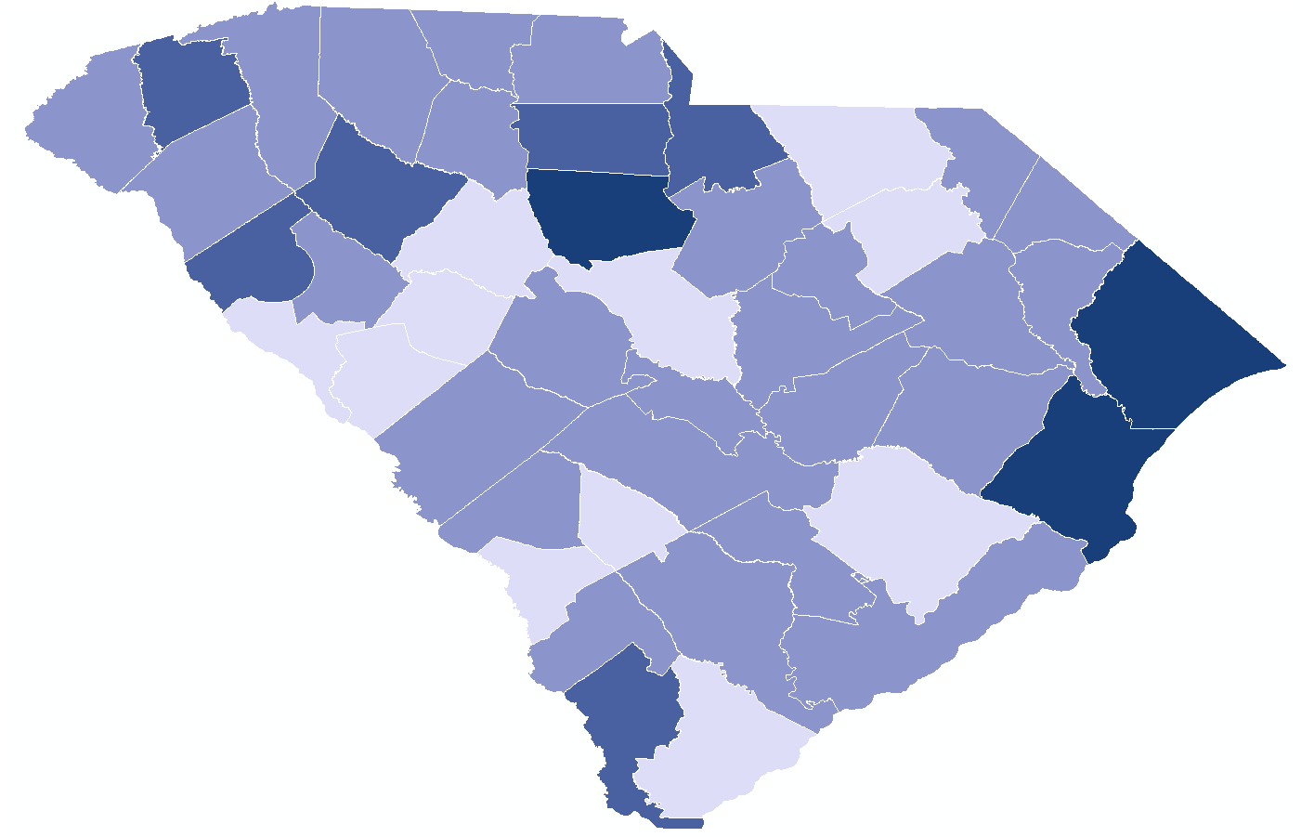
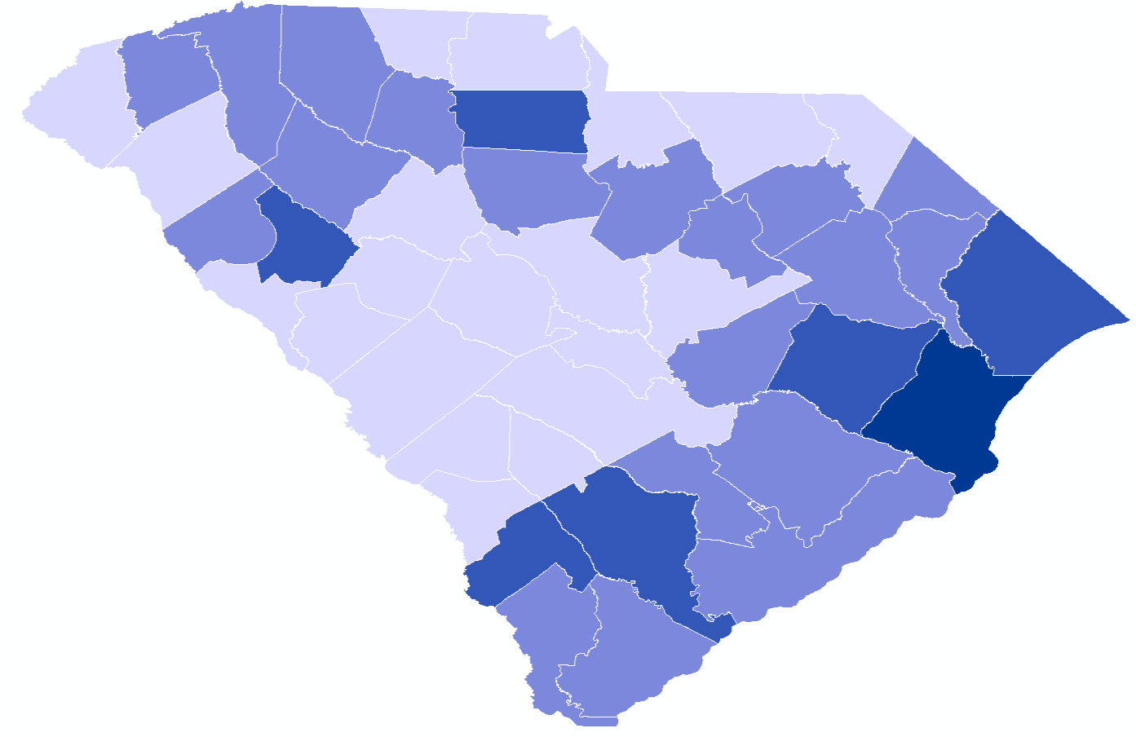
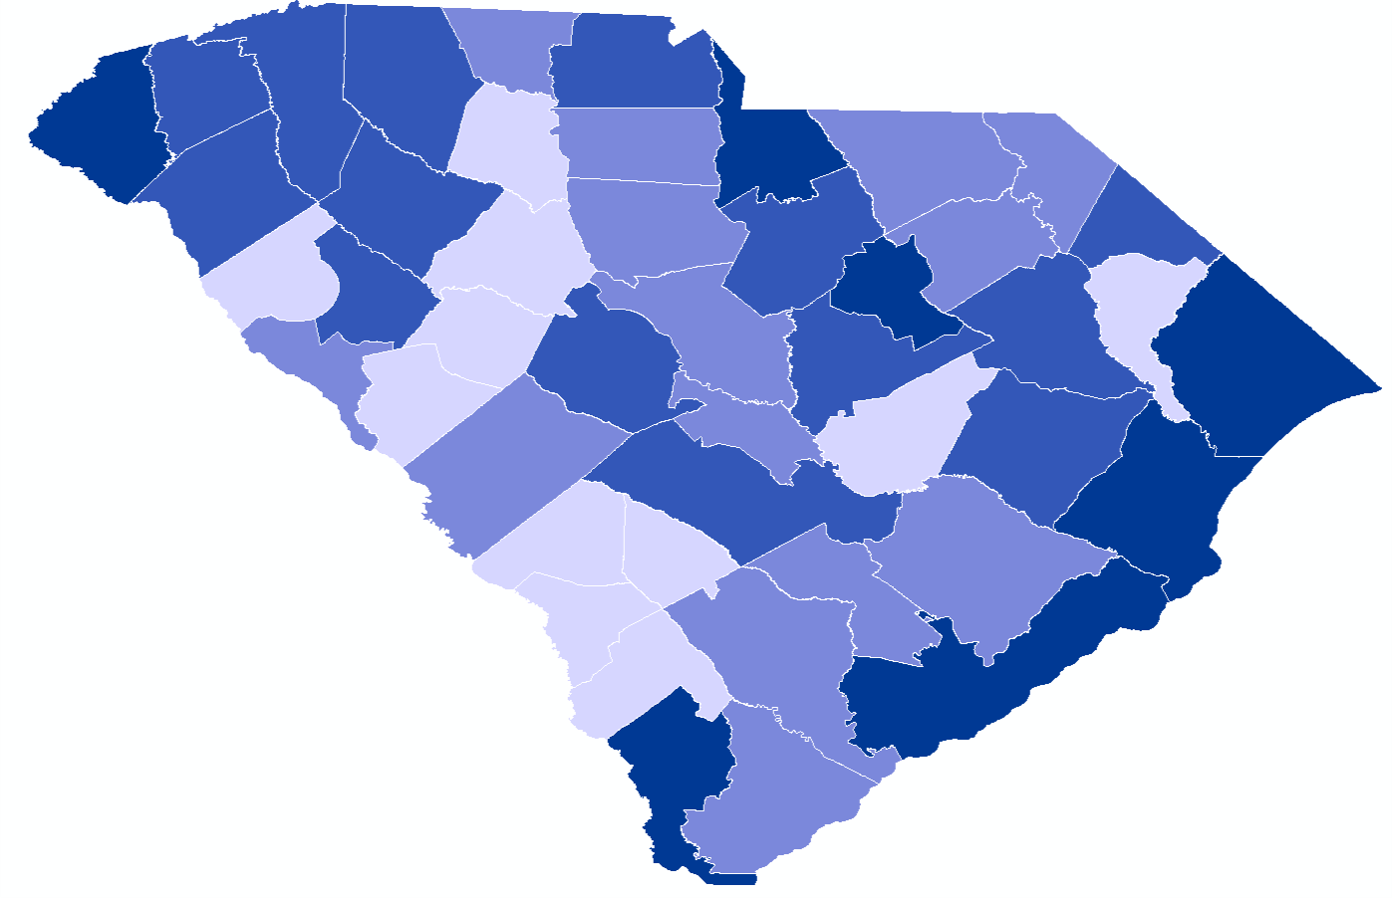
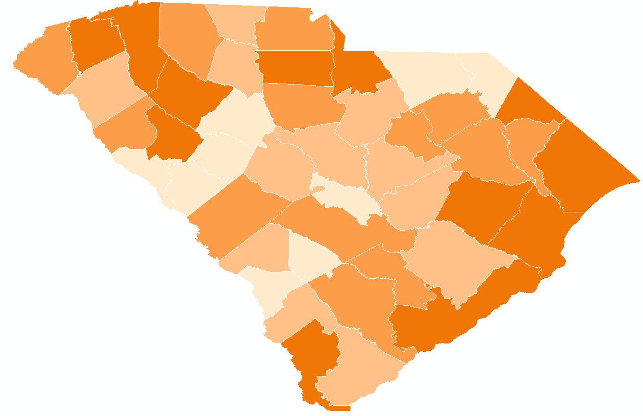
2019 Key Overdose Measures
(rate per 100,000 population - darker color indicates higher burden)
EMS Naloxone Administration Rate
Opioid-involved Overdose Hospitalization Rate
Opioid-involved Overdose Death Rate
Opioid Overdose Burden Rankings
Top 10 Counties 1. (tie) Georgetown
1. (tie) Horry
3. Jasper
4. Pickens
5. Charleston
6. (tie) Chester
6. (tie) Williamsburg
6. (tie) Dillon
9. (tie) Laurens
9. (tie) Greenville
Final overdose burden rankings calculated using the rankings from the 3 overdose measures; multiple counties tied in final rankings.

Slide 2
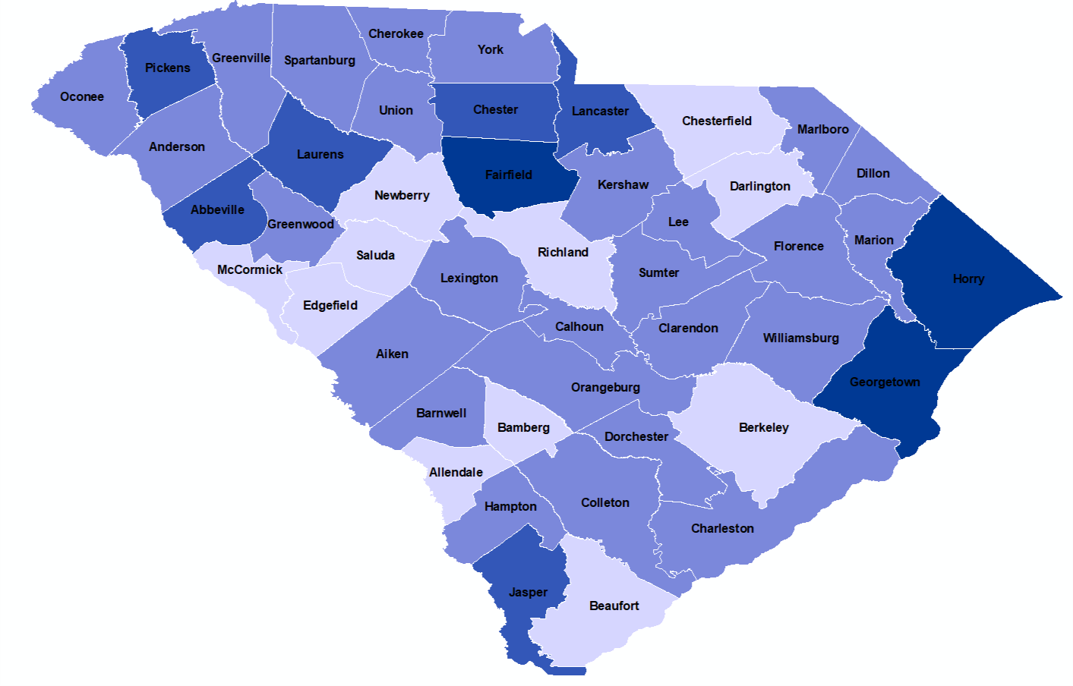
Burden Measure- EMS Naloxone Administrations
(Rate per 100,000 population)
Top 10 Counties 1.Fairfield
2. Georgetown
3. Horry
4. Chester
5. Lancaster
6. Jasper
7. Pickens
8. Laurens
9. Abbeville
10. Greenville
Naloxone administration counted solely from EMS personnel; excludes naloxone administered from non-EMS entities or individuals; county administration count & rate data available on Justplainkillers.com/data

Slide 3
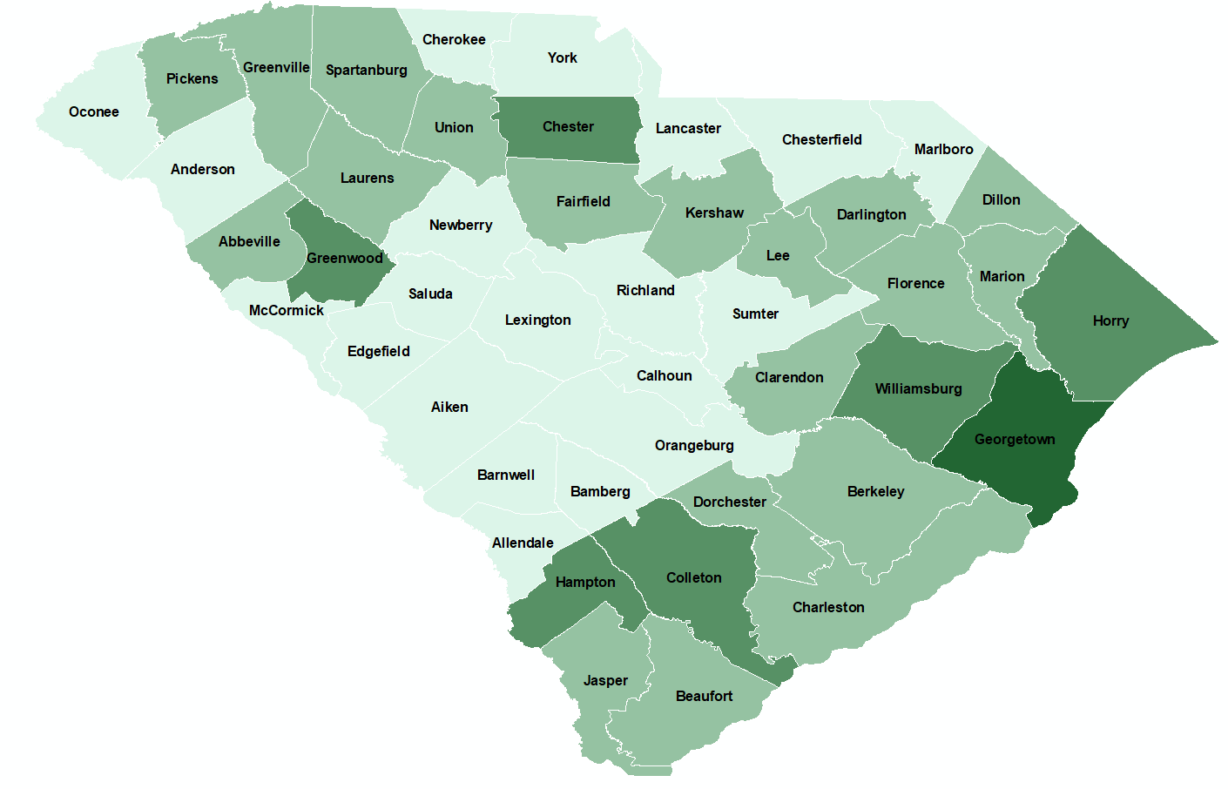
Burden Measure- Opioid-Involved Overdose Hospitalizations
(Rate per 100,000 population)
Top 10 Counties 1. Georgetown
2. Williamsburg
3. Horry
4. Colleton
5. Chester
6. Greenwood
7. Hampton
8. Darlington
9. Pickens
10.Marion
A hospitalization refers to an individual admitted to and discharged from an inpatient or emergency department setting due to overdosing on opioids; county hospitalization count & rate data available on Justplainkillers.com/data

Slide 4
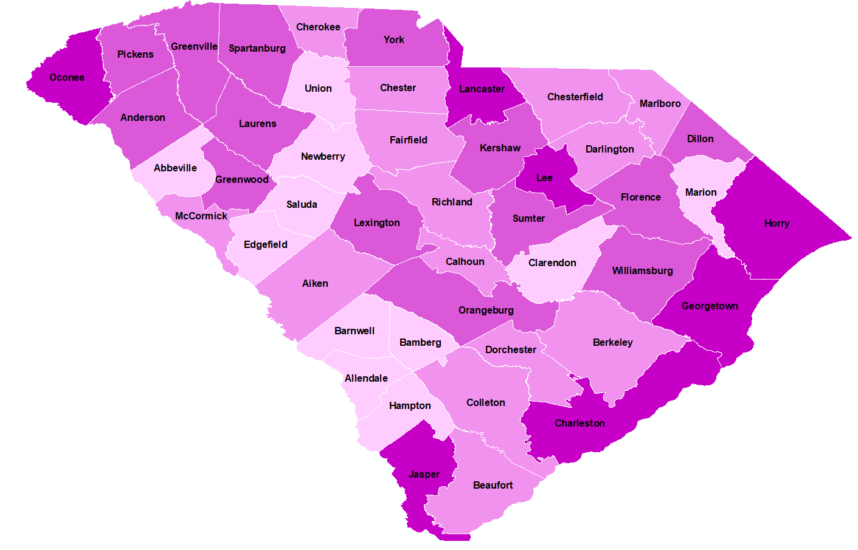
Burden Measure- Opioid-involved Overdose Deaths
(Rate per 100,000 population)
Top 10 Counties 1. Horry
2. Lancaster
3. Jasper
4. Georgetown
5. Charleston
6. Lee
7. Oconee
8. Greenville
9. Orangeburg
10.Dillon
An opioid-involved overdose death is classified by ICD-10 cause-of-death codes; county mortality count & rate data available on Justplainkillers.com/data

Slide 5
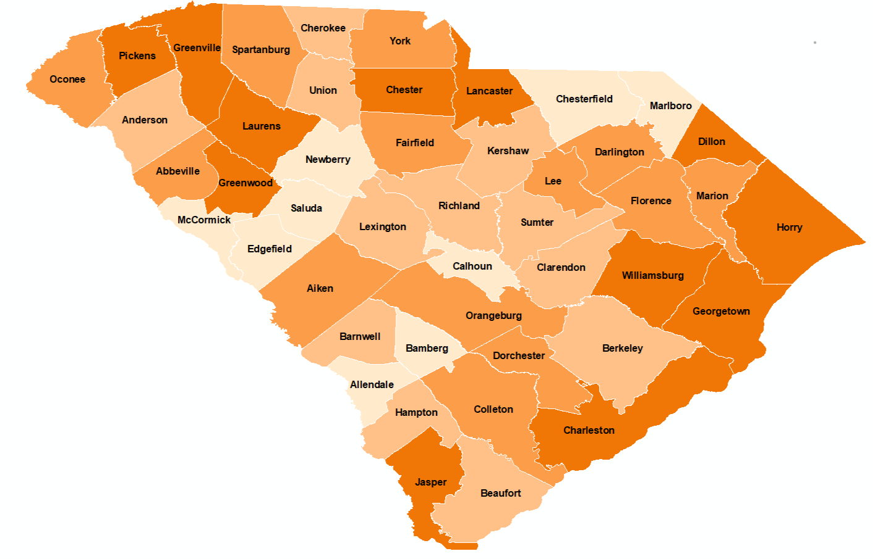
Opioid Overdose Burden Rankings
Top 10 Counties 1. (tie) Georgetown
1. (tie) Horry
3. Jasper
4. Pickens
5. Charleston
6. (tie) Chester
6. (tie) Williamsburg
6. (tie) Dillon
9. (tie) Laurens
9. (tie) Greenville
Final burden rankings are based on the average ranking for three overdose measures: EMS Naloxone administration rate, opioid-involved overdose hospitalization rate, and opioid-involved overdose death rate.

